Slide 1
6 things we can all start doing about climate change today
Mim Saxl
Low Carbon West Oxford & Kids Climate Action (KidsCAN)

Slide 2
Introduction
Mim Saxl, Low Carbon West Oxford
Session L.O.: Find out about 6 things we can all start trying to do today to look after our planet and prevent climate change

Slide 3
Session outline
Introduction
Climate vs weather – what’s the difference?
WHO can do something about climate change?
WHAT we can do – 6 things
Introducing the KidsCAN Climate Challenge
Activity
Sharing gallery

Slide 4
Question: What’s the difference?
Climate | Weather

Slide 5
Question: What’s the difference?

Slide 6
Question: What’s the difference?
Climate | Weather
Is the average weather over a longer time e.g. 30 years | Is the state of the atmosphere around us at a particular time
Takes a long time to change | Can change in minutes
Tells you what you need in your closet | Tells you what to wear each day

Slide 7
Has anyone noticed any funny weather?

Slide 8
February 2019

Slide 9
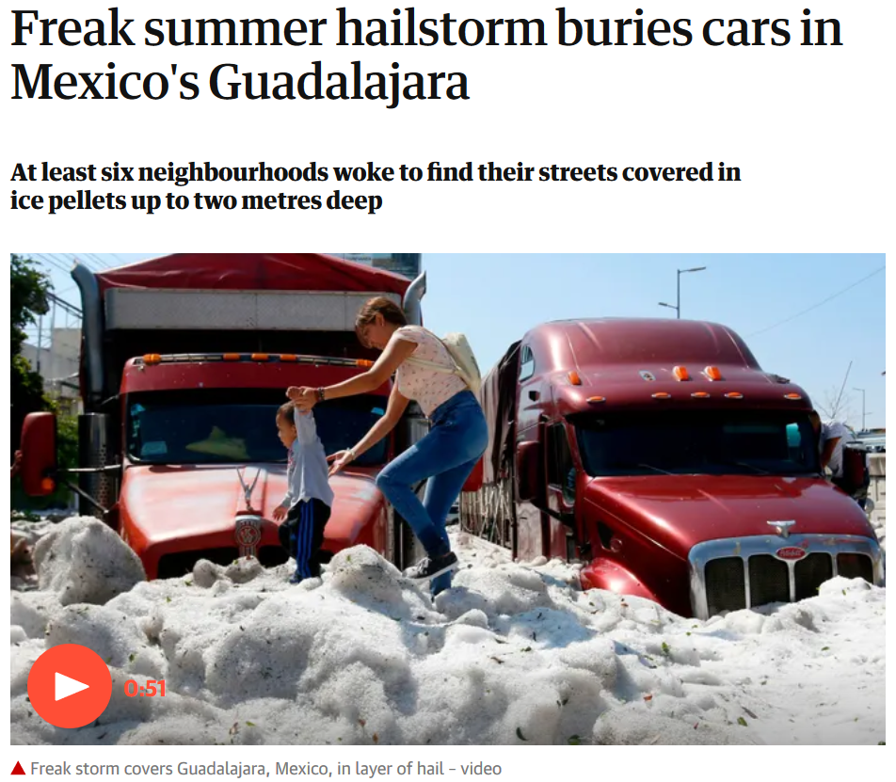
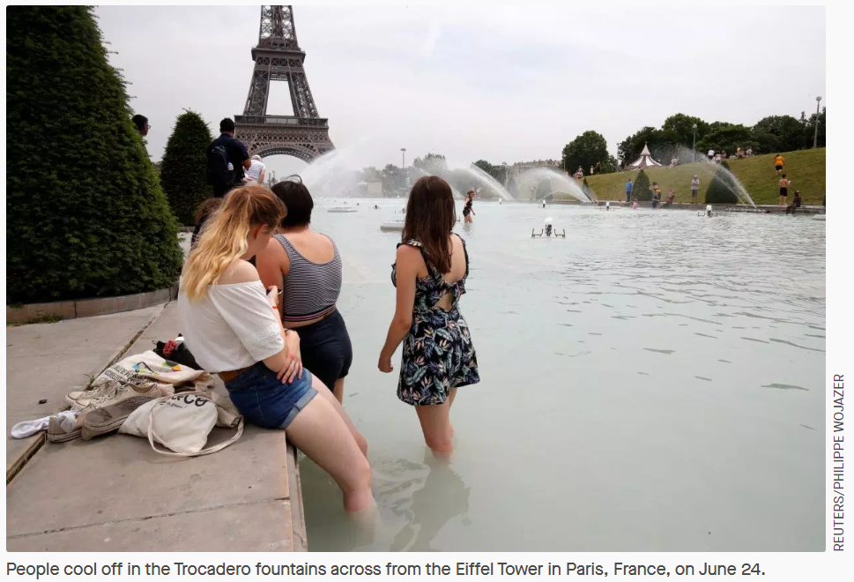
June 2019

Slide 10
…the weather is weird, and scientists can show some of that is the result of the climate warming… …and as the climate changes, we’ll see more weird weather!

Slide 11
Question: WHO can do something about climate change?

Slide 12
WHO can do something about climate change?
There are a lot of powerful people who can make a difference.
A lot of them are adults.
And the good news is there are lots of adults working really hard on this problem.

Slide 13
WHO can do something about climate change?
But, if you want to, there are things
YOU
can do to help

Slide 14
Question: WHAT can we do?

Slide 15
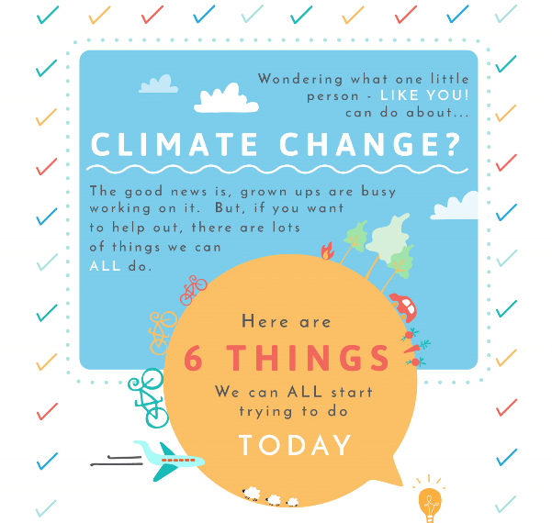

Slide 16
Our 6 areas of action:
1) How we travel 2) What we buy and how we treat our stuff 3) How we keep warm at home 4) How we treat the natural world around us 5) What we eat 6) How we talk to others about climate change

Slide 17
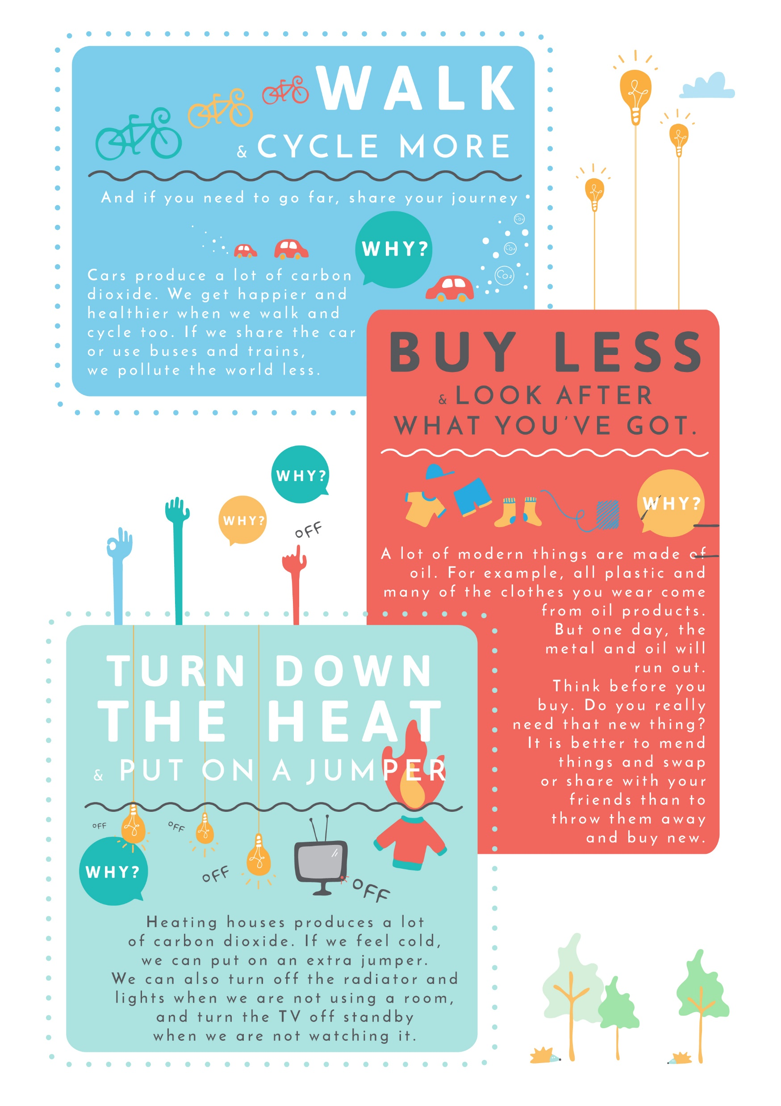
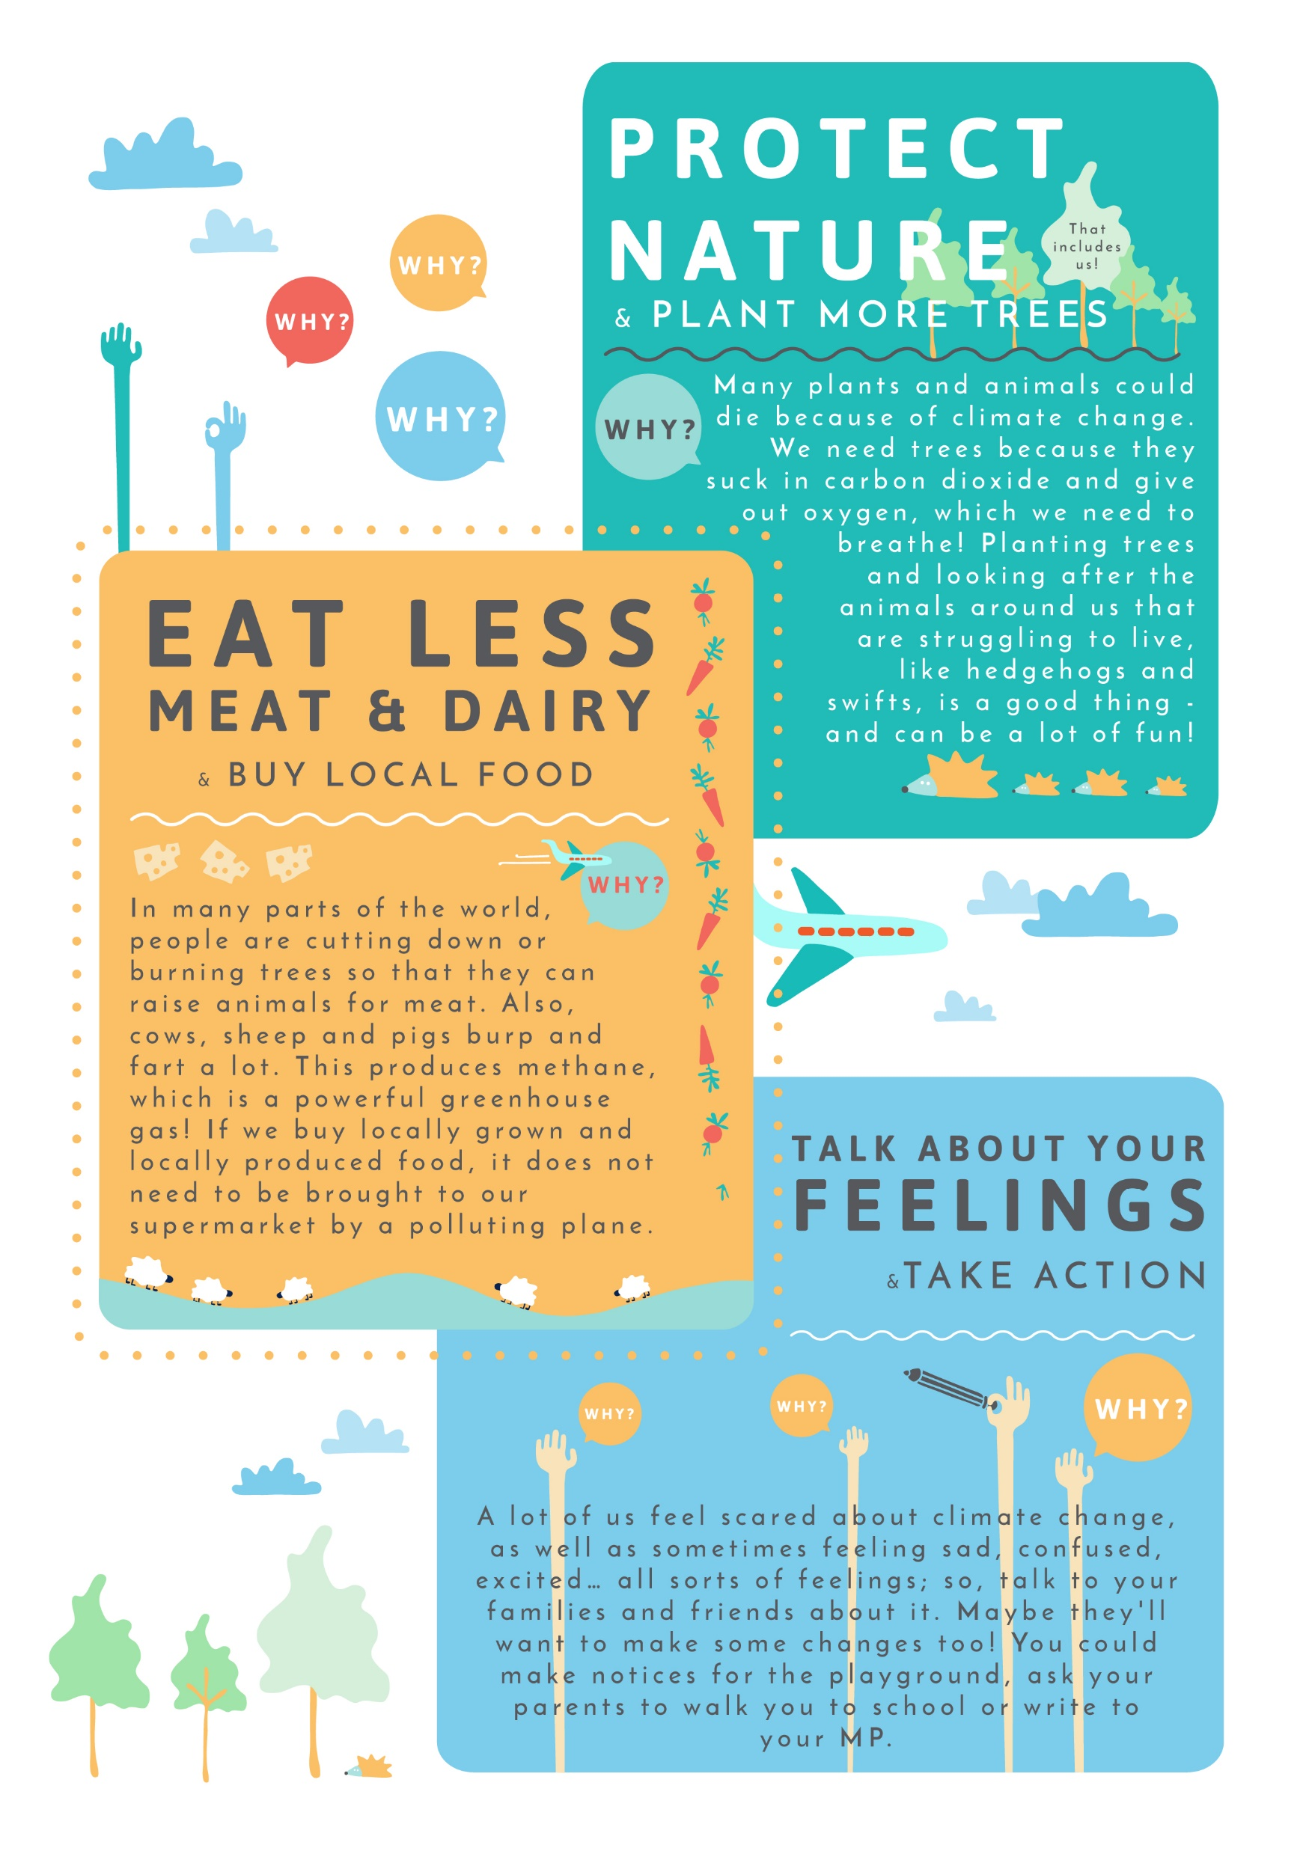

Slide 19
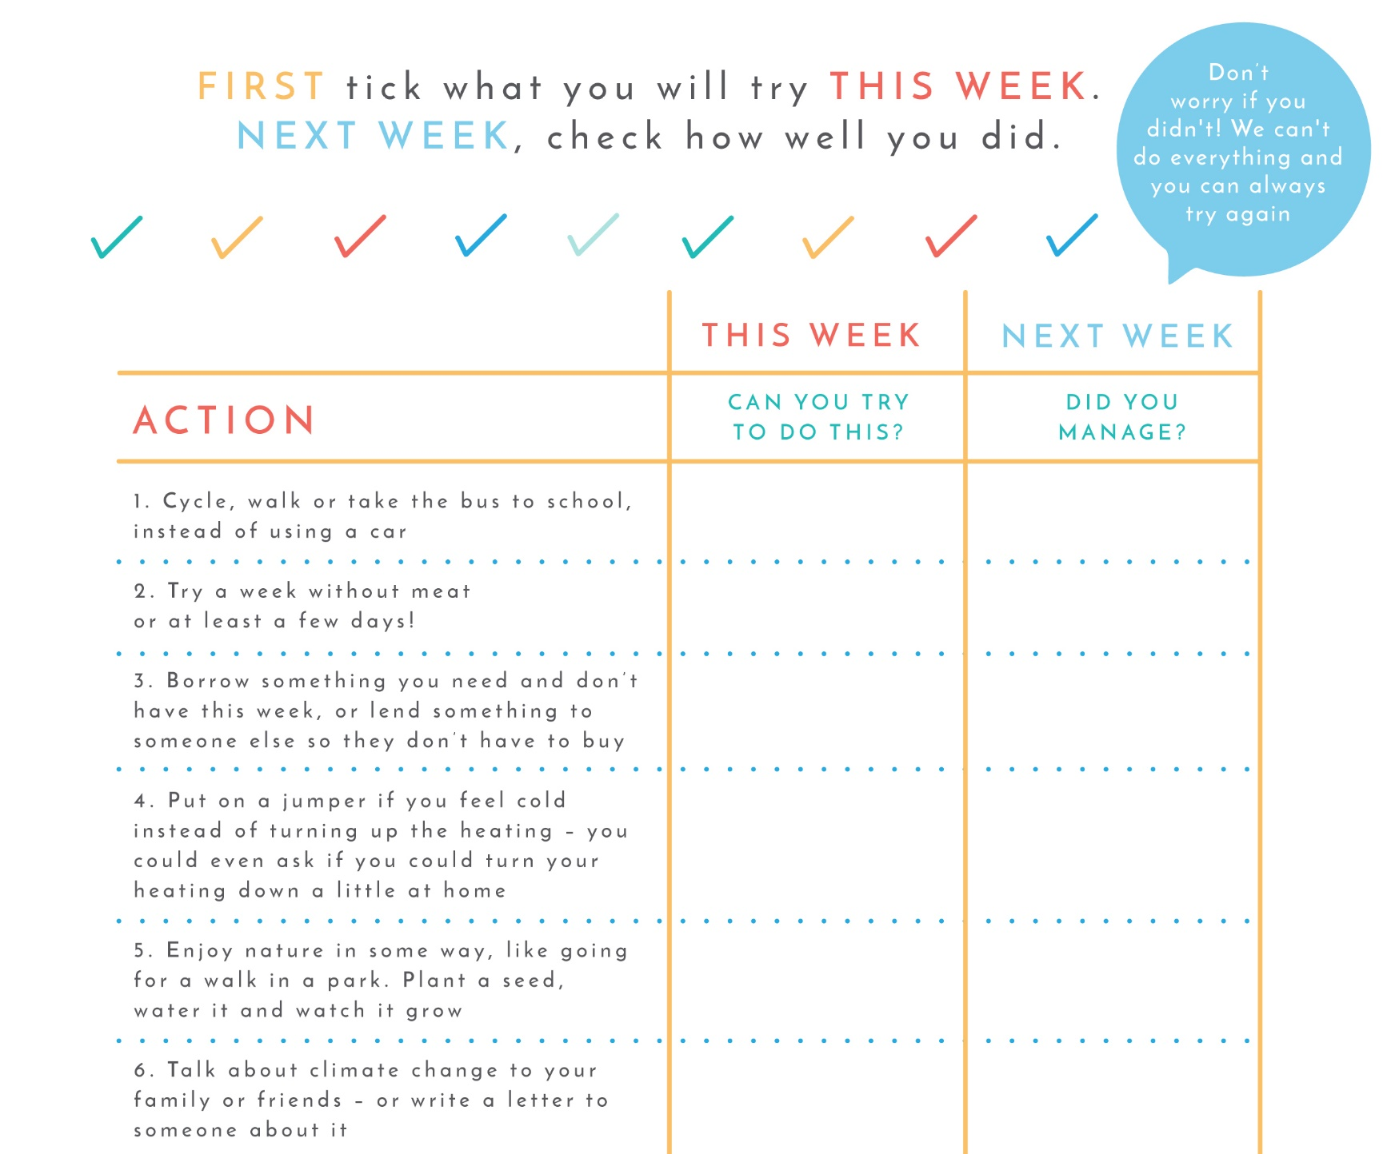

Slide 20
With someone next to you…
Have a look at the 6 things
Look at the Climate Challenge
Chat about your own ideas &what you think you might try this week…
When you’re ready, tick some boxes in the first column
Come back to the next column next week

Slide 21
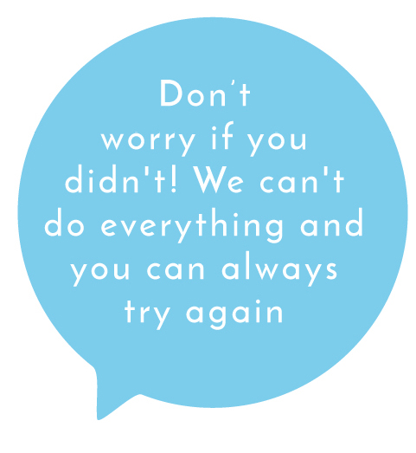
REMEMBER…
Only tick column 1 today – column 2 is another time soon (e.g. next week)
You don’t need to do them all
These are just ideas – you might have your own you prefer to try
This is NOT a test! Don’t worry if you don’t manage to do what you tick…

Slide 22
Activity
DRAW A PICTURE
Something you love in the natural world
You doing one of the six things this week e.g. riding your bike instead of driving to an after-school activity; eating a yummy meat-free sandwich
OR
WRITE A LETTER
To someone in our list of powerful people / to a friend of family member
You could tell them what you feel about climate change, and what action you’d like them to take

Slide 23
Closing sharing gallery
Tidy up, leave your work on your desk if you are happy for others to look at it
Walk round to look at what others have made and share your thoughts

Slide 24
THANK YOU!
Mim Saxl
Low Carbon West Oxford
mim@lcwo.org.uk, www.lowcarbonwestoxford.org.uk
Kids Climate Action Network (KidsCAN)
www.kidsclimateaction.org

